Slide 1

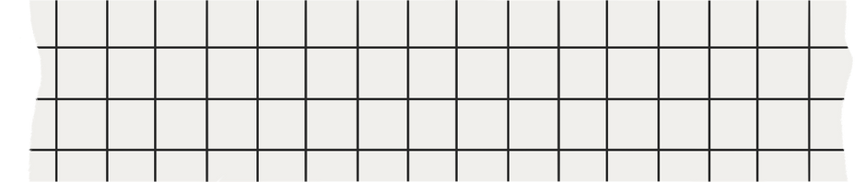

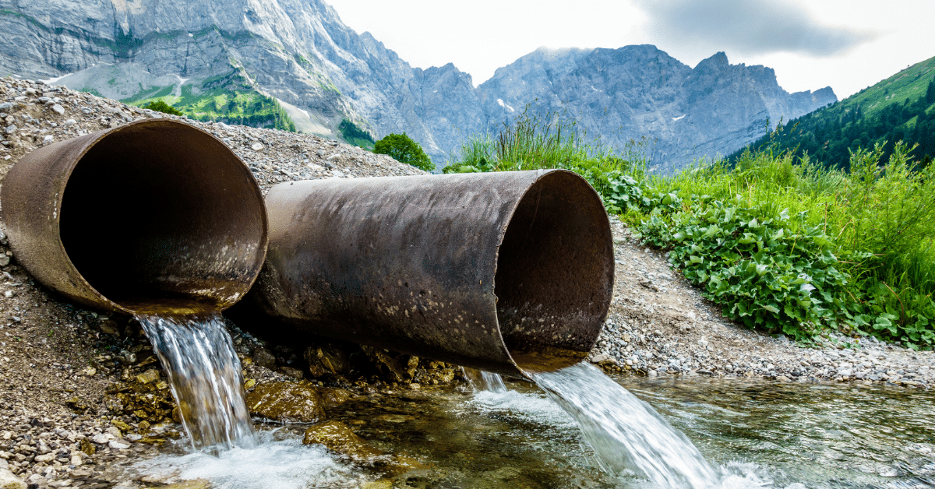
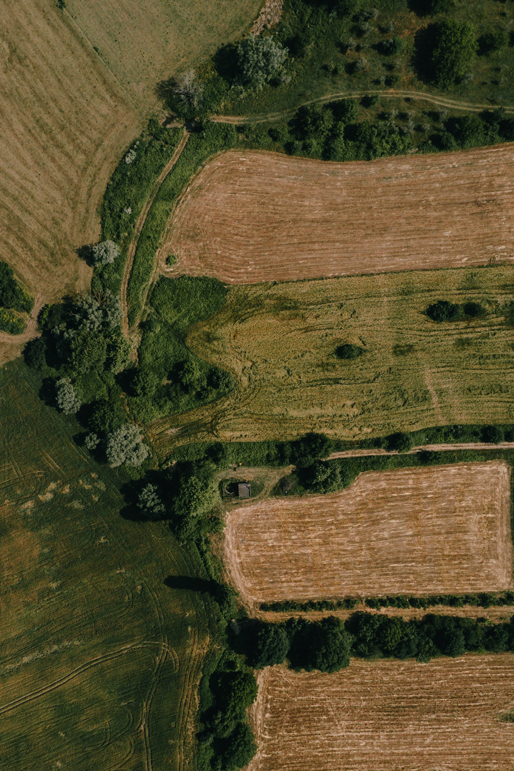
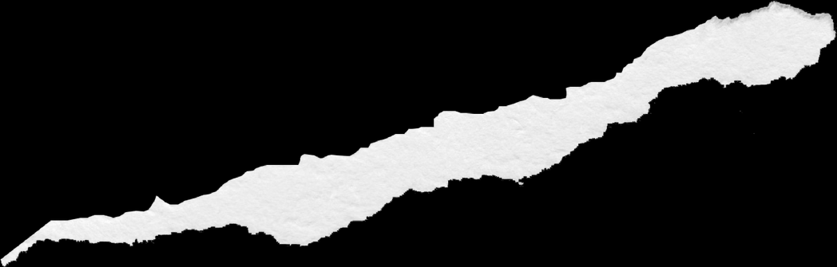
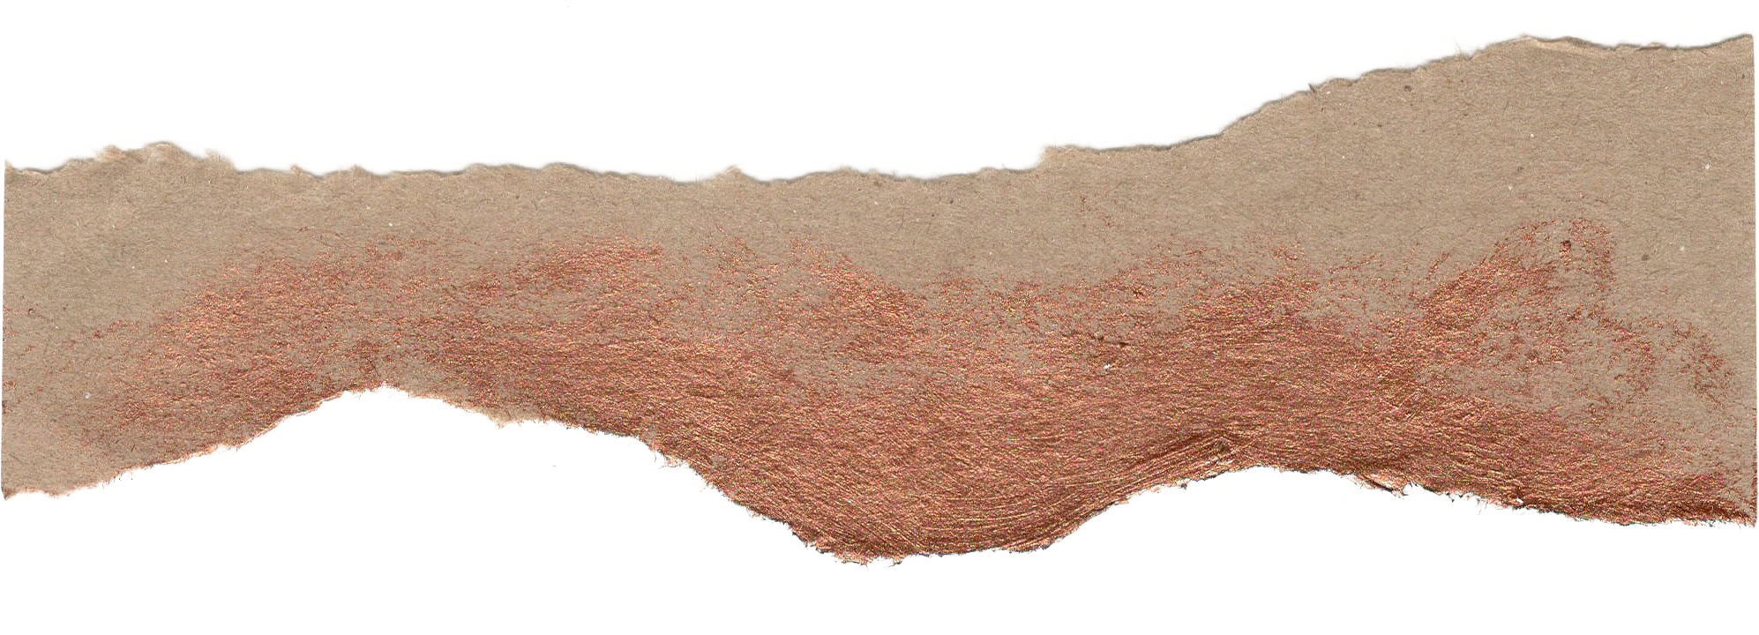
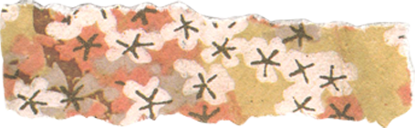
ECONOMETRICS PROJECT
Tanishk
Baljyot
Sanyam
Jaskaran

Slide 2
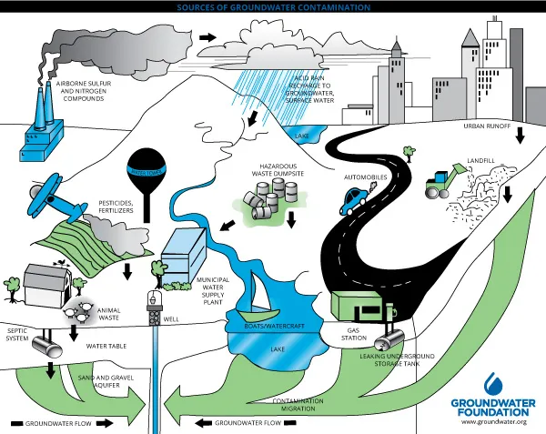
Groundwater Pollution caused due to calcium

Slide 3

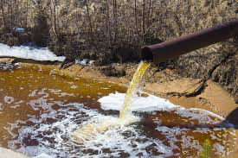
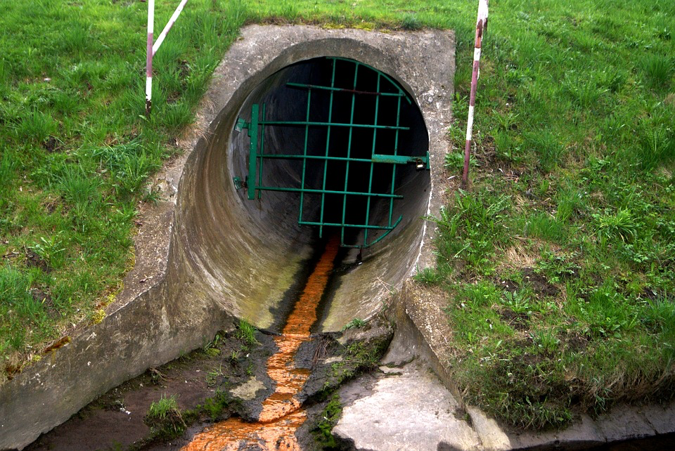
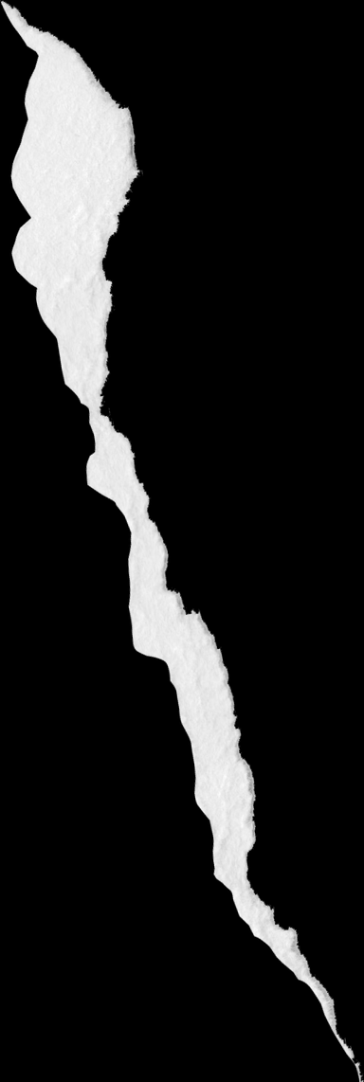
INTRODUCTION
With respect to human health, chemical elements in the environment (i.e., contained within the water, soil, and air) can be present in amounts that may be deficient or excessive. Each chemical element can be thought of as a “medicine” or a “poison”; it depends on the dose (Paracelsus). There are three main exposure routes for chemical elements to reach the human organism: ingestion, inhalation, and dermal contact [1]. In a natural, non-contaminated environment, ingestion of food and water is considered to be the main exposure route of chemical elements to humans. Chemical elements soluble in drinking water occur mainly in the ionic form, and are generally directly bioavailable to humans. On the other hand, chemical elements in soils may enter the crops only if dissolved in soil water (moisture) and thus be ingested through the food chain. The input of chemical elements from soils to humans through the food chain, and their potential manifestation into health effects depends on many factors, mainly their concentration, bioavailability, and speciation

Slide 4

Data Merging
In the equation ,
While the calcium concentration in district i at time 𝑡 and the Gini coefficient of district i at time 𝑡 are directly taken from the dataset, the SDP value is taken from the state to which district 𝑖i belongs.
Different districts within the same state may have different economic development and infrastructure levels, leading to variations in the State Domestic Product (SDP) and potentially affecting groundwater quality differently.
While merging the data for the Gini index, we encountered situations where districts were subdivided into smaller ones. But since we were available with the Gini indices of districts in the Year 2010-11 , we assigned the Gini index value from the years 2010-11 of the parent district to all the newly formed districts.
While merging the data, we encountered numerous missing values in the Gini index and SDP rows. We assumed that these missing values were due to a Missing Completely At Random (MCAR) mechanism. This assumption implies that the missingness is unrelated to the observed or unobserved variables in the dataset, allowing us to proceed with our analysis without significant bias.

Slide 5
Regression equation
State Domestic Product, or SDP, is the total value of goods and services produced during any financial year within the boundaries of district i at the t ‘th year .
GWQ i,t: Groundwater quality in district i at the t th year . For this project The ground water quality indicator is Calcium.
u i,t is the random error term that captures unobserved factors that are not included in this model
Notes:
﻿
▸ Our regression model is quite simple but powerful. We're examining the relationship between groundwater quality (GWO) and economic output (SDP).
⚫ The equation we're using is GWQ1 = Bo + B1SDP¿¿+μ¿‚μ·
Explanation:
In this equation, GW Qit represents the calcium concentration, our indicator of groundwater quality.
• We're using SDP (Net State Domestic Product) as a predictor of groundwater quality. Why? Well, economic growth often leads to increased industrialization, urbanization, and agricultural activities, all of which can impact groundwater quality.
Think about it: as industries grow, there's more potential for pollution. Urbanization can lead to more demand for water resources, while agricultural practices may involve the use of fertilizers and pesticides that can seep into groundwater.
The uit term accounts for factors we might not have measured, like natural variations,
measurement errors, or other environmental and economic factors influencing groundwater quality.

Slide 6
REGRESSION
Min: -74.81 Median: -7.15 Max: 433.57 1Q: -25.85 3Q: 17.46 | R-squared: 0.022 Adj. R-squared: 0.022 F-statistic: 168.2 P-value: <2.2e-16
No. Observations:7309 | Df Residuals: 7307 Df Model: 1
coeff | coeff | std error | t | P>|t| | 0.025 | 0.975
const | 55.19 | 0.702 | 78.58 | 0.00 | 54.008 | 56.727
SDP | 3.24 e-05 | 2.49e-06 | 12.97 | 0.00 | 2.68e-05 | 3.64e-05

Slide 7
Variable name | Coefficient (Standard Error)
No. Observations | 7309
Df Residuals | 7307
Df Model | 1
R-squared: | 0.022
F-statistic: | 165.0
Adj. R-squared: | 0.022
const | 55.35674 (0.693)
SDP | 3.16 e-05 (2.46e-06)
T stat(const) Tstat(SDP) | 79.845 12.845

Slide 8
Intercept (const): The intercept represents the expected groundwater quality (calcium concentration) when all other factors are held constant, which in this context means when the economic output (SDP) is zero. However, it's important to note that an SDP of zero isn't a meaningful scenario in this context. Instead, the intercept serves as a reference point for understanding the relationship between economic output and groundwater quality.
The R-squared value indicates that only a small portion of the variability in calcium can be explained by SDP alone, suggesting the presence of other factors influencing calcium levels that weren't included in the model.
The F-statistic is 165.0 with a very low p-value (2.32e-37), suggesting that the overall regression model is statistically significant. This means that there is strong evidence that economic output has a significant effect on groundwater quality.
T-Statistics and P-Values: The t-statistic for the intercept is 79.845 with a p-value less than 0.0001, indicating that the intercept is significantly different from zero. The t-statistic for SDP is 12.845 with a p-value less than 0.0001, indicating that the coefficient for SDP is significantly different from zero.

Slide 9
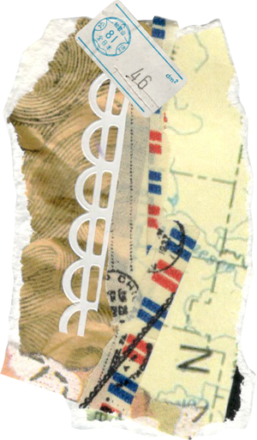
Key Takeaways
The coefficient for SDP suggests a positive relationship between economic output and groundwater quality.
However, the low R-squared value indicates that economic output explains only a small portion of the variation in groundwater quality.
The t-tests and p-values confirm that both the intercept and the coefficient for SDP are statistically significant.
The F-test indicates that the overall regression model is statistically significant.
Confidence intervals provide a range within which the true coefficients are likely to fall.

Slide 10
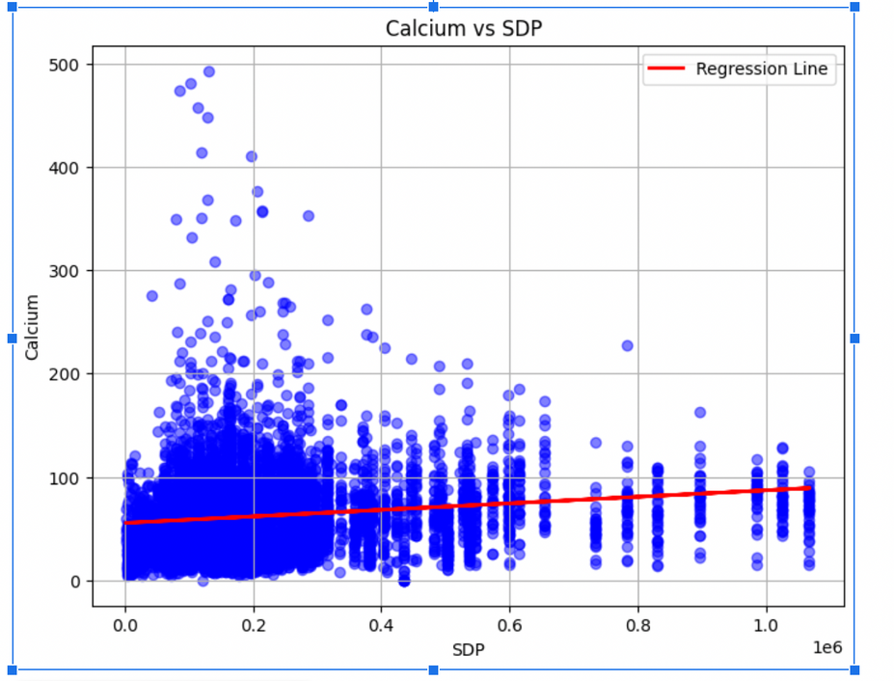
PLOTS
Groundwater Quality Indicator vs. SDP This scatter plot shows the groundwater quality indicator (calcium) on the y-axis and SDP on the x-axis. Some observations:
At lower SDP values, there is a dense concentration of points between 0 -100, indicating lower calcium levels, meaning good groundwater quality
As SDP increases, the groundwater quality indicator values become more spread out due to various factors. Higher economic development often correlates with increased industrialization and urbanization, leading to higher pollution levels and a wider range of groundwater quality.
The pattern suggests a potential non-linear relationship between groundwater quality and economic development, which may follow an inverted U-shape (environmental Kuznets curve).
Notes:
Groundwater Quality Indicator vs. SDP This scatter plot shows the groundwater quality indicator (calcium) on the y-axis and SDP on the x-axis. Some observations:
At lower SDP values, there is a dense concentration of points between 0 -100, indicating lower calcium levels, meaning good groundwater quality , which also expected as Lower economic output (SDP) often correlates with less industrial activity and lower pollution levels, which can lead to lower calcium levels in groundwater.
As SDP increases, the groundwater quality indicator values become more spread out due to various factors. Higher economic development often correlates with increased industrialization and urbanization, leading to higher pollution levels and a wider range of groundwater quality. While some areas may experience improvements in groundwater quality due to better waste management practices, others may continue to face contamination from industrial and agricultural activities. Therefore, we observe both higher and lower quality groundwater at higher SDP levels.
The pattern suggests a potential non-linear relationship between groundwater quality and economic development, which may follow an inverted U-shape (environmental Kuznets curve).

Slide 11
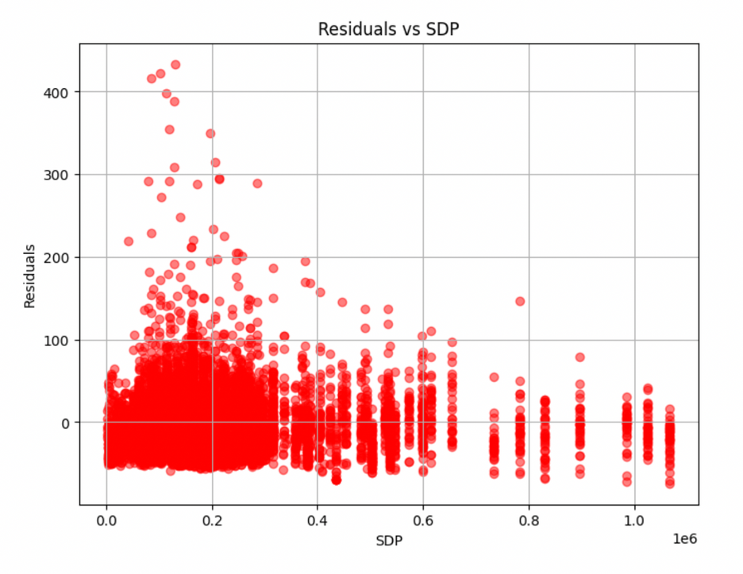
Residuals vs. SDP This scatter plot displays the residuals from the linear regression model on the y-axis against the SDP values on the x-axis. A few key observations:
At lower SDP values, the residuals are clustered around zero, indicating a good fit of the linear model in this range.
As SDP increases, the residuals become more spread out, with both positive and negative residuals present. This suggests that the linear model may not be capturing the relationship well at higher SDP levels.
There appears to be a pattern of increasing variance in the residuals as SDP increases, indicating potential heteroscedasticity (non-constant variance of residuals).
The distribution of residuals is not completely random, with some patterns visible, hinting at possible non-linearities in the relationship.
The residual plot suggests heteroscedasticity and potential non-linearities, while the data plot hints at a possible inverted U-shaped relationship (environmental Kuznets curve).
Notes:
Residuals vs. SDP This scatter plot displays the residuals from the linear regression model on the y-axis against the SDP values on the x-axis. A few key observations:
At lower SDP values, the residuals are clustered around zero, indicating a good fit of the linear model in this range.
As SDP increases, the residuals become more spread out, with both positive and negative residuals present. This suggests that the linear model may not be capturing the relationship well at higher SDP levels.
There appears to be a pattern of increasing variance in the residuals as SDP increases, indicating potential heteroscedasticity (non-constant variance of residuals).
The distribution of residuals is not completely random, with some patterns visible, hinting at possible non-linearities in the relationship.

Slide 12
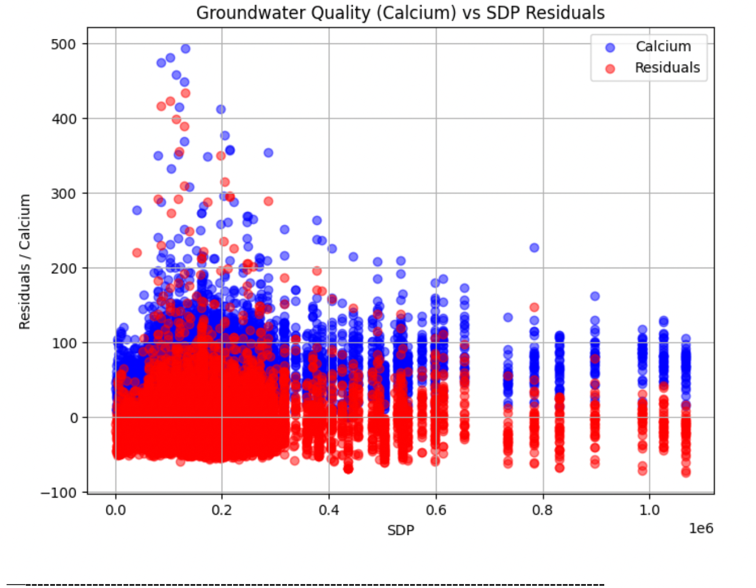

Slide 13
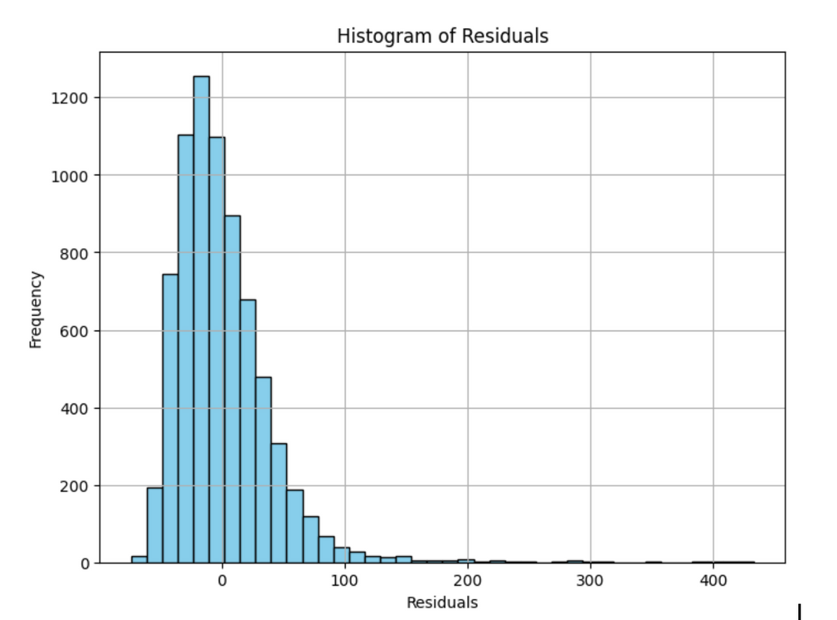
HISTOGRAM
The histogram displaying the sum of residuals equal to -5.212275e-12 indicates that the model's residuals, which are the differences between the predicted values of calcium levels and the actual observed values, are well-centered around zero.
The histogram is most densely populated between 0 and 50 residuals, where the highest frequency of residuals occurs, indicating that a majority of the residuals are clustered around this range , which is what we desired .
The spread of the histogram is greater towards the right side, indicating positive skewness, with a significant tail extending into higher values of residuals. This suggests the presence of outliers, where larger residuals are less frequent but still present.
These observations indicate that the model may not effectively capture all the variability in the data, especially at higher values of the predictor. This aligns with our findings in the second part, suggesting the potential need for using an environmental Kuznets equation to better estimate the data.

Slide 14
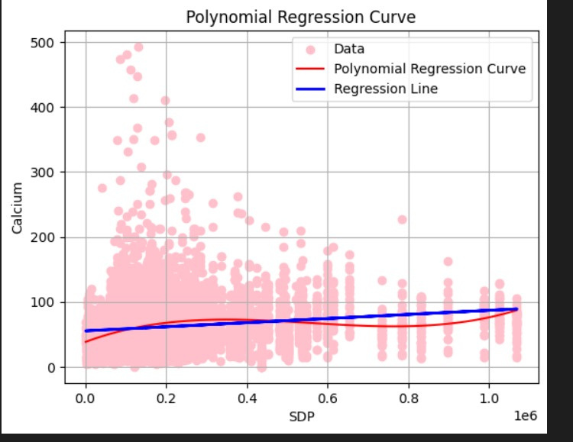
NEW REGRESSION ORDER
Regression Equation used:
State Domestic Product, or SDP, is the total value of goods and services produced during any financial year within the boundaries of district i at the t ‘th year .
GWQ i,t: Groundwater quality in district 𝑖 at the t th year . For this project The ground water quality indicator is Calcium.

Slide 15
Results
coeff | Estimates | std error | t | P>|t|
Intercept | 3.960e+01 | 1.844e+00 | 21.016 | <2e-16
SDP | 1.978e-04 | 1.121e-05 | 17.648 | <2e-16
I(SDP^2) | -3.978e-10 | 3.0311e-11 | --13.125 | <2e-16
I(SDP^3) | 2.383e-16 | 2.123-e-17 | 11.224 | <2e-16
GINI | -9.813e+00 | 6.109e+00 | -1.606 | 0.108
coeff | Estimates | std error | t | P>|t|
Intercept | 4.111e+01 | 2.502e+00 | 16.431 | <2e-16
SDP | 2.355e-04 | 1.489e-045 | 15.821 | <2e-16
I(SDP^2) | -4.910e-09 | 4.022e-10 | -12.209 | <2e-16
I(SDP^3) | 2.938e-16 | 2.819-e-17 | 10.422 | <2e-16
GINI | -1.1169e+01 | 8.082e+00 | -1.447 | 0.147
coeff | Estimates
Intercept | 4.111e+01
SDP | 2.355e-04
I(SDP^2) | -4.910e-09
I(SDP^3) | 2.938e-16
GINI | -1.1169e+01
Min | -72.70
Median | -6.12
Max | 432.82
1Q | -24.81
3Q | 16.70
Observations: 7187 R-square:0.05112 Adj.R-square: 0.05059
F-Statistics: 96.74 P-value: <2.2e-16 D.O.F: 7182
Results

Slide 16
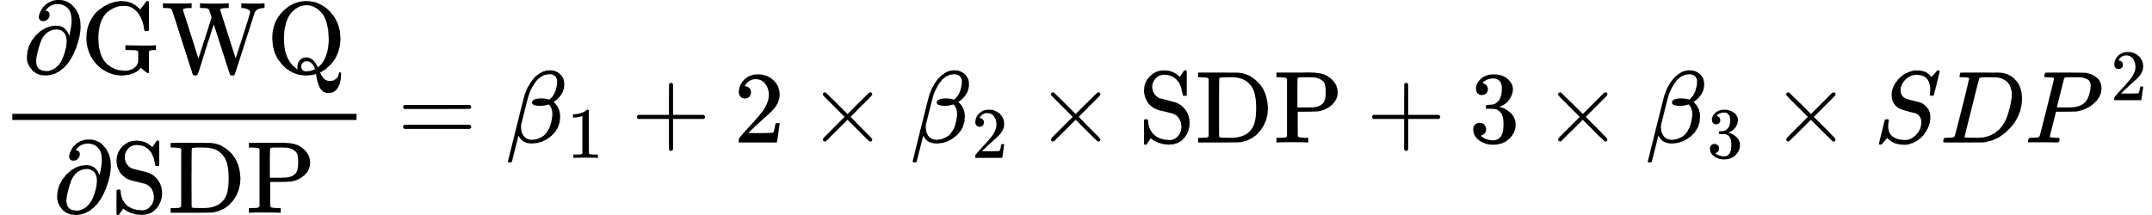
Interpretation
Intercept (41.11): When all independent variables are constant, the estimated GWQ is 41.11 units.
Coefficient for Gini (-11.69): For each unit increase in the Gini coefficient, the estimated GWQ decreases by 11.69 units, holding other variables constant.
The negative coefficient for Gini (-11.69) suggests that the estimated GWQ decreases as income inequality increases. This implies that regions with greater income inequality tend to have lower water quantity..
Since the coefficients for SDP, SDP2, and SDP3 are highly correlated with each other, it’s difficult to interpret each coefficient individually. However, considering other independent variables such as Gini to be constant, we can rewrite the equation as:
Now, taking the partial derivative of GWQ with respect to SDP , we get:
This implies that the change in GWQ for a one-unit increase in SDP depends on the values of β1,β2,β3 and the specific value of SDP.

Slide 17
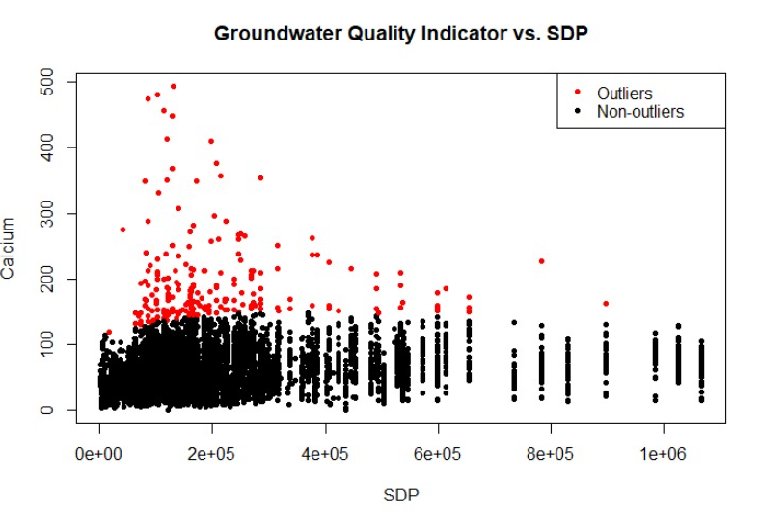
Outliers
A standardized version is to consider a t th observation to be an outlier if: RSTUDENT exceeds a cutoff which can be set as ±2 or ±3, as discussed in lecture 15. Here is the scatterplot of outliers at cutoff ±2; we observe 214 rows of the dataset considered as outliers, which is lower at cutoff ±3, of about 91 observations.
The scatter plot reveals that most data points align closely with a general trend, displaying a positive, negative, or neutral relationship between the Groundwater Quality Indicator and SDP. The non-outliers follow a typical pattern, indicating a consistent association between the two variables. Outliers are extreme data points that deviate significantly from the majority, potentially skewing statistical analyses and models. The outliers have been dealt with using 2 methods:

Slide 18
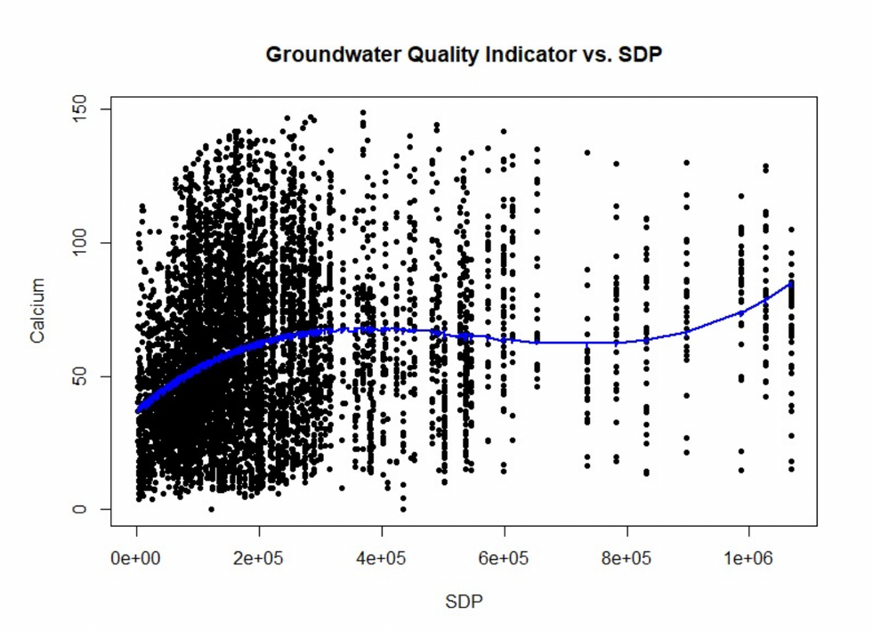
coeff | Estimates | std error | t | P>|t|
Intercept | 3.960e+01 | 1.844e+00 | 21.016 | <2e-16
SDP | 1.978e-04 | 1.121e-05 | 17.648 | <2e-16
I(SDP^2) | -3.978e-10 | 3.0311e-11 | --13.125 | <2e-16
I(SDP^3) | 2.383e-16 | 2.123-e-17 | 11.224 | <2e-16
GINI | -9.813e+00 | 6.109e+00 | -1.606 | 0.108
Observations:6973 R-square:0.0762 Adj.R-square:0.075
F-Statistics: 143.3 P-value: <2.2e-16 D.O.F:6968
Trimming: Removing the outliers we have found from the dataset here, we are taking the example of cutoff ±2 and trimming the outliers' data. Then, we run the regression model on the updated data again.
The high t values and extremely low p values indicate the overall statistical significance of the model. Also, predictor variables (up to the fourth order) exhibit significant associations with the dependent variable, and the model provides a reasonable fit for the data.

Slide 19
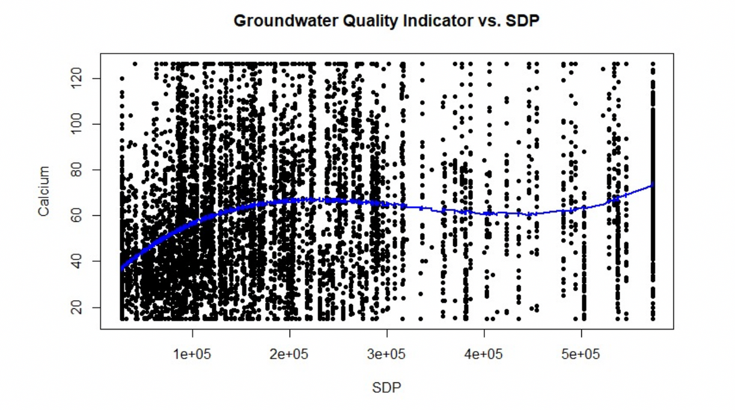
coeff | Estimates | std error | t | P>|t|
Intercept | 2.909e+01 | 2.304e+00 | 12.624 | <2e-16
SDP | 4.362e-04 | 2.363e-05 | 18.466 | <2e-16
I(SDP^2) | -1.462e-09 | 9.986e-11 | -14.682 | <2e-16
I(SDP^3) | 1.484e-15 | 1.149-e-16 | 12.917 | <2e-16
GINI | -1.058e+01 | 6.878e+00 | -1.538 | 0.124
Observations:7187 R-square:0.0842 Adj.R-square:0.0837
F-Statistics: 165.1 P-value: <2.2e-16 D.O.F:7182
Winsorization : we make a quantile function to calculate 5th and 95th percentiles of each column, and then replace the values below the 5th percentile with the 5 percentile and the values above 95th percentile with the 95th percentile.
In summary, winsorizing the data has likely mitigated the influence of outliers on the regression coefficients while maintaining the overall significance and interpretation of the model. The significant predictor variables (SDP, SDP^2, SDP^3) remain influential in explaining the variation in the dependent variable, while the Gini term continues to be insignificant.

Slide 20
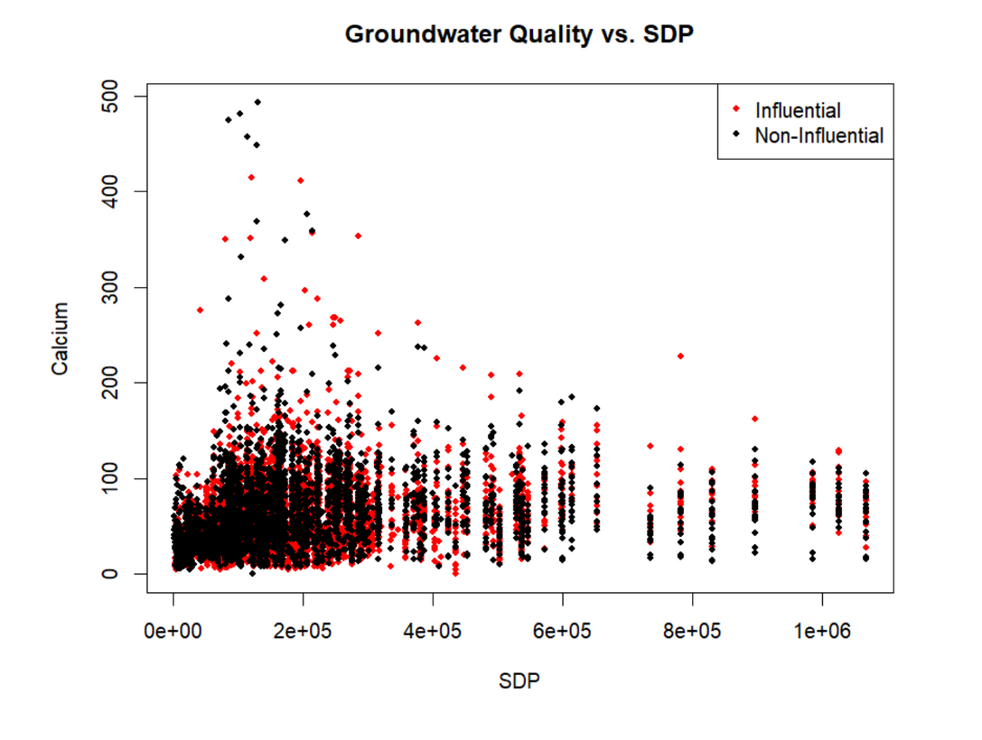
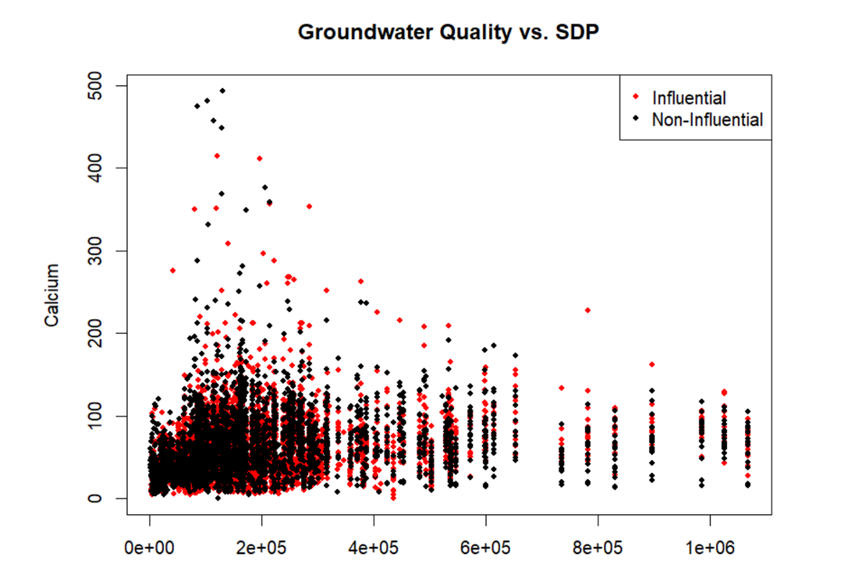
Influential Observations
As given in slides, there are two methods two find influential observations:
DFFITS:
We observe 7183 rows considered as influential data.
DFBETA:
We observed 6925 rows of data that were considered influential

Slide 21
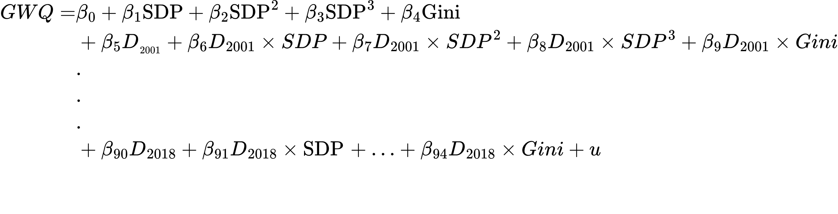
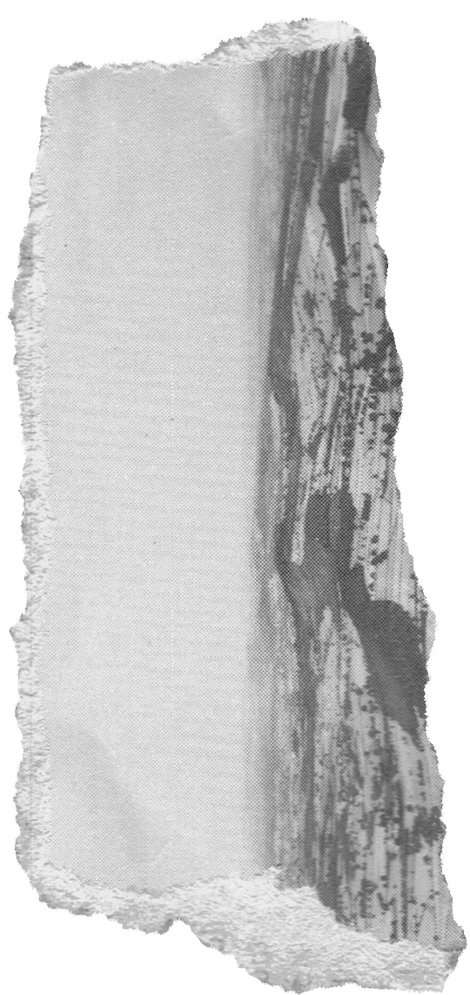
Year-wise Kuznet Curve Analysis with Dummy Variables and Interaction Terms
In the regression model, GWQ is the dependent variable.
β0 is the intercept. β1, β2,and β3 are coefficients for the linear, quadratic, and cubic terms of SDP (State Domestic Product) respectively. β4 is the coefficient for the Gini coefficient.
D 2001 to D 2018 are dummy variables for the years 2001 to 2018 respectively.
β 5 to 𝛽94 are the coefficients associated with the dummy variables and their interactions with
SDP,SDP^2,SDP^3,Gini
In the regression model, we have added interaction terms for each year, extending the Kuznets curve equation to include year-specific effects.
Intercept (Base Category - Year 2000): The intercept coefficient represents the average value of the dependent variable (calcium concentration) when all independent variables are constant. In this case, it represents the average calcium concentration in the year 2000 when SDP, SDP^2, SDP^3, and Gini are all constant .

Slide 22
coeff | Estimates | std error | t | P>|t|
Intercept | 3.015e+01 | 1.527e+01 | 1.975 | 0.48363
SDP | 1.182e-03 | 2.714e-04 | 4.35 | 1.35e-05
I(SDP^2) | -7.925e-09 | 1.963e-09 | -4.036 | 5.49e-05
I(SDP^3) | 1.500e-14 | 4.17-e-15 | 3.597 | 0.000324
GINI | 2.964e+01 | 3.553e+01 | -0.834 | 0.404136
2005 | -2.969e+01 | 1.849e+01 | -1.605 | 0.108456
2005 SDP | -2.606e-04 | 3.084e-04 | -0,845 | 0.397997
2005 I(SDP^2) | 3.630e-09 | 2.153e-09 | 1.686 | 0.91896
2005 I(SDP^3) | -9.258e-15 | 4.394e-15 | -2.107 | 0.035172
2005 GINI | 8.469e+01 | 4.850e+01 | 1.746 | 0.080849
Min | -93.85
Median | -5.12
Max | 422.39
1Q | -21.87
3Q | 15.65
Observations:7187 R-square:0.1338 Adj.R-square:0.1233
F-Statistics:11.65 P-value: <2.2e-16 D.O.F:7092

Slide 23
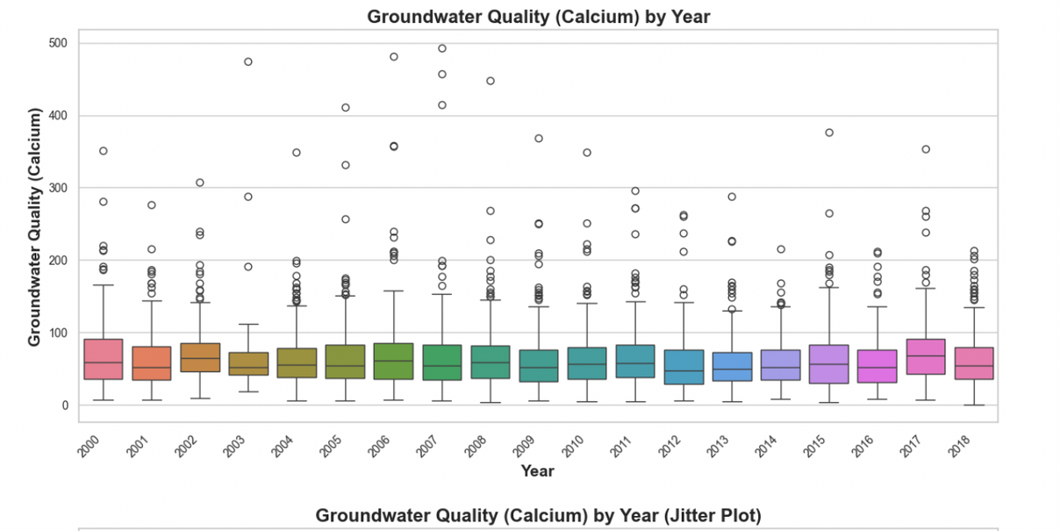
Using the Intercept with D 2005 Interaction Term: The intercept for the
year 2005 is -29.69. This means that when all other variables are held constant,
the Groundwater Quality (GWQ) in 2005 is expected to be 29.69 units lower
compared to the base year (2000). However, this difference is not statistically
significant (p = 0.108).
Gini Coefficient in 2005: The coefficient for the interaction term between
year 2005 and Gini is 84.69. This indicates that in 2005, for each unit increase in
the Gini coefficient, the GWQ is expected to increase by 84.69 units. However,
this effect is not statistically significant (p = 0.081).

Slide 24
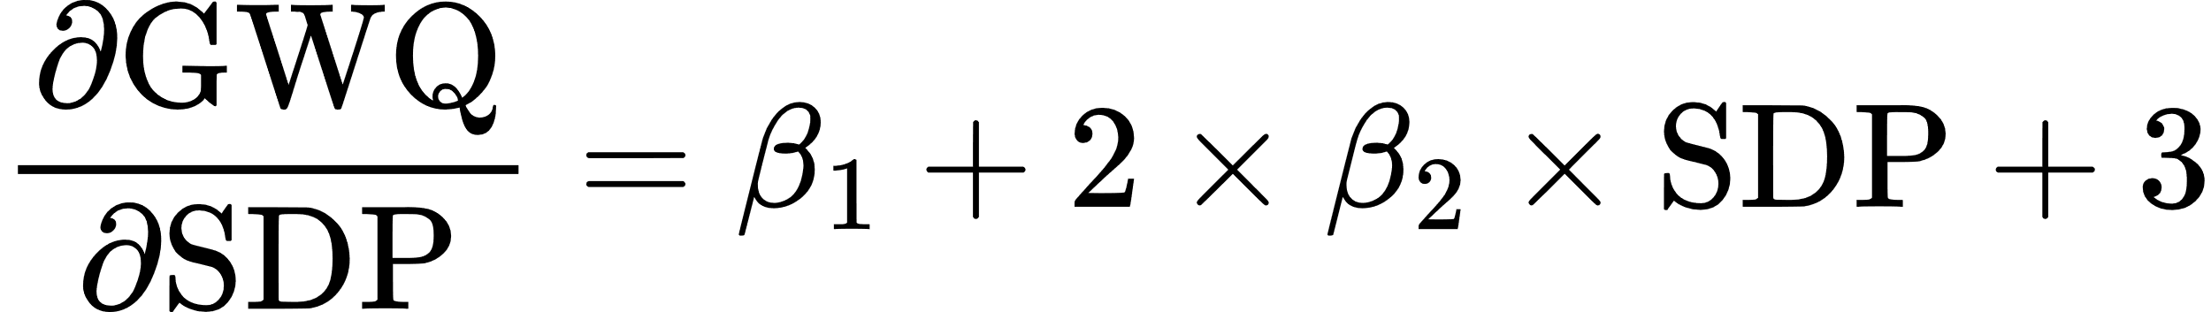
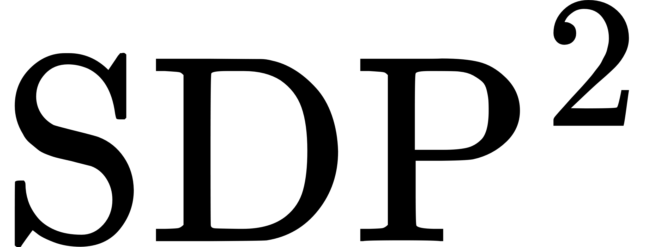
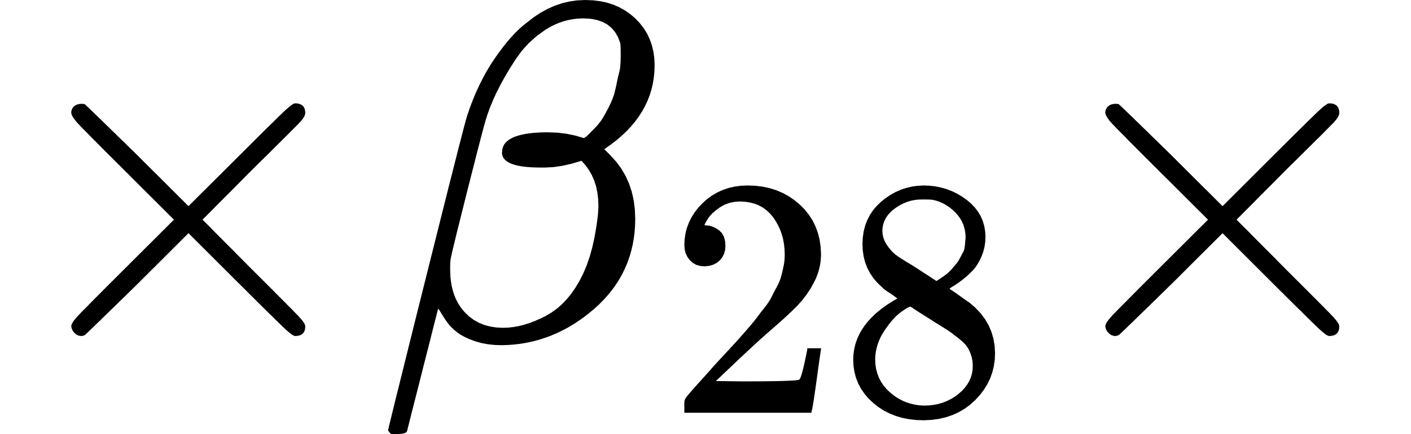
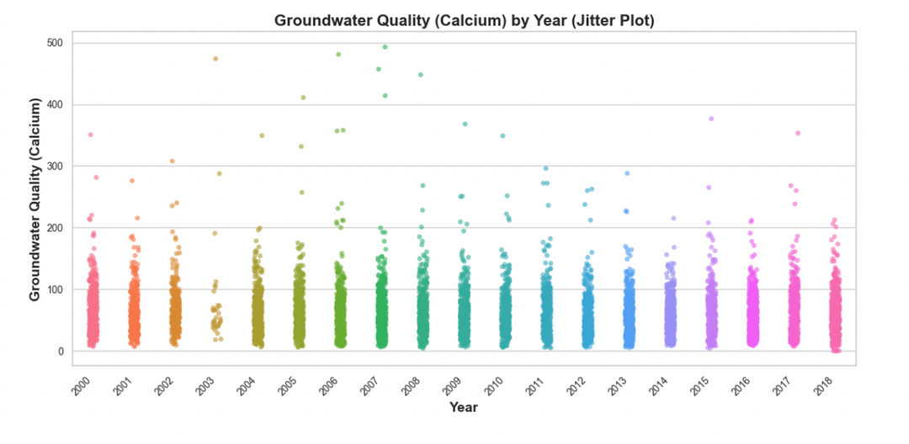
Interpreting Coeffecients of SDP
Since the coefficients for SDP, SDP2, and SDP3 are highly correlated with each other, it’s difficult to interpret each coefficient individually. However, considering other independent variables such as Gini to be constant, we can rewrite the equation as:
Now, taking the partial derivative of GWQ with respect to SDP , we get:
This implies that for a one-unit increase in SDP in the year 2005, holding other variables constant, the GWQ is expected to change by the sum of the coefficients β1, β26, plus twice the sum of the coefficients β2, β27, times the value of SDP, plus three times the sum of the coefficients β3, β28, times the square of the value of SDP.

Slide 25
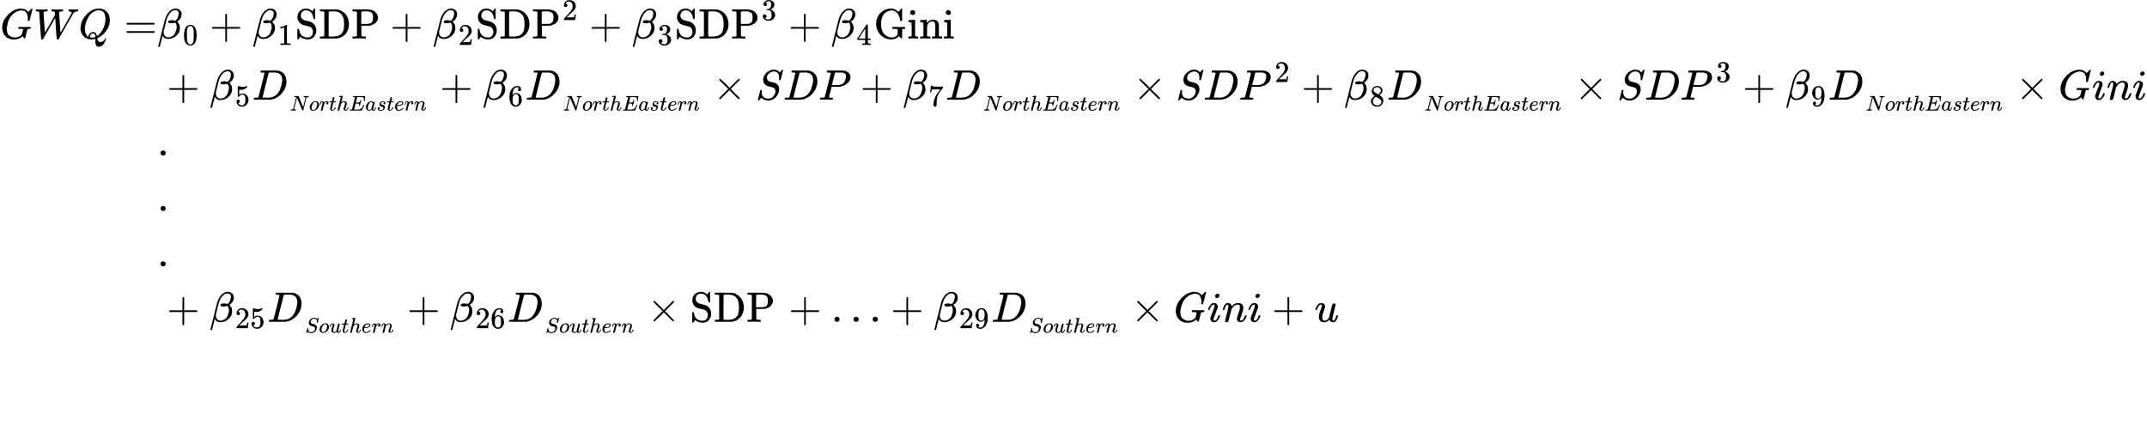
Region-wise Kuznet Curve Analysis with Dummy Variables and Interaction Terms
In the regression model, GWQ is the dependent variable.
β0 is the intercept. β1, β2, and β3 are coefficients for the linear, quadratic, and cubic terms of SDP (Standardized Data Product) respectively. β4 is the coefficient for the Gini coefficient.
D_NorthEastern to 𝐷_Southern are dummy variables for the regions.
β 5 to 𝛽29 are the coefficients associated with the dummy variables and their interactions with
SDP,SDP^2,SDP^3,Gini .
In the regression model, we have added interaction terms for region, extending the Kuznets curve equation to include region -specific effects.
Intercept (Base Category - Northern REgion): The intercept coefficient represents the average value of the dependent variable (calcium concentration) when all independent variables are constant. In this case, it represents the average calcium concentration in the Northern Region when SDP, SDP^2, SDP^3, and Gini are all constant .

Slide 26
coeff | Estimates | std error | t | P>|t|
Intercept | 4.783e+01 | 6.713e+00 | 7.125 | 1.14e-12
SDP | 5.719e-04 | 1.291e-04 | 4.430 | 9.55e-06
I(SDP^2) | -3.215e-09 | 9.801e-10 | -3.280 | 0.001042
I(SDP^3) | 6.029e-15 | 2.146e-15 | 2.810 | 0.004971
GINI | -4.058e+01 | 1.746e+01 | -2.324 | 0.020167
Central Region | -2.490e+1 | 9.466e+00 | -2.630 | 0.008549
Central SDP | 1.558e-04 | 1.526e-04 | 1.021 | 0.307281
Central I(SDP^2) | 1.106e-10 | 1.052e-09 | 0.105 | 0.916249
Central I(SDP^3) | -2.581e-15 | 2.197e-15 | -1.175 | 0.240140
Central GINI | 3.159e+01 | 2.322e+01 | 1.361 | 0.173590
Min | -85.58
Median | -3.91
Max | 14.36
1Q | -20.33
3Q | 14.36
Observations: 7187 R-square: 0.1794 Adj. R-square: 0.1761
F-Statistics: 53.95 P-value: < 2.2e-16 D.O.F: 7157

Slide 27
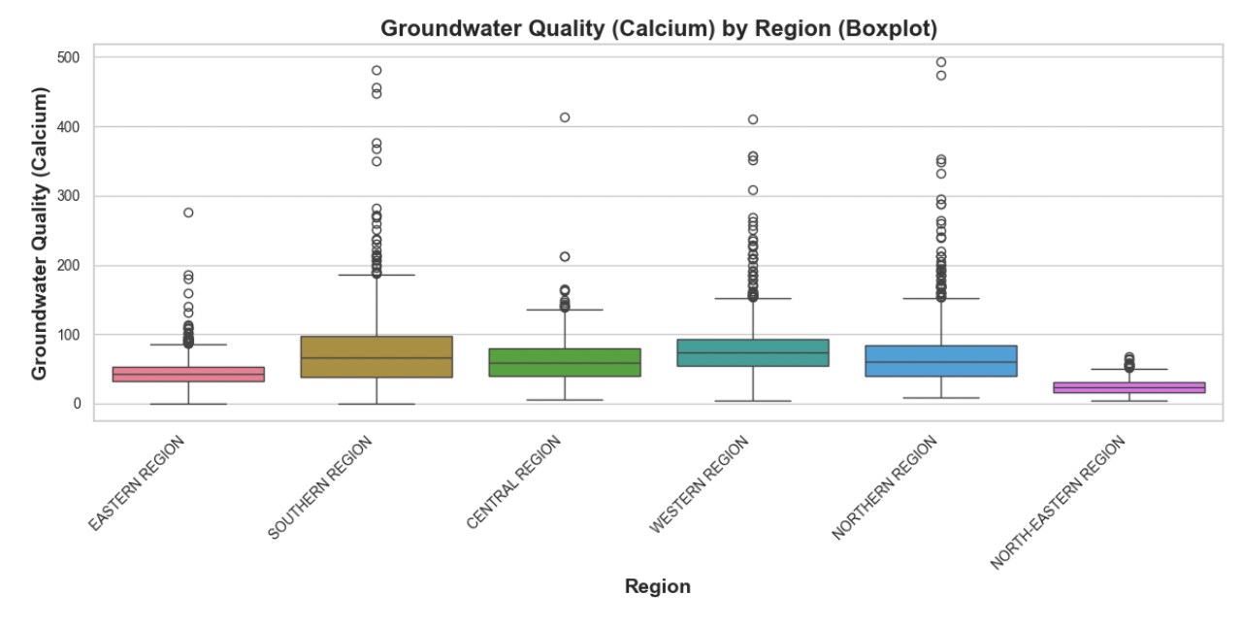
Using the Intercept with D Central Region Interaction Term: The intercept for the
Central Region is -24.9. This means that when all other variables are held constant,
the Groundwater Quality (GWQ) in Central Region is expected to be 24.9 units lower
compared to the base region (Nothern Region). However, this difference is not statistically significant (p = 0.108).
Gini Coefficient in Central Region: The coefficient for the interaction term between Central Region and Gini is 31.59. This indicates that in Central Region, for each unit increase in the Gini coefficient, the GWQ is expected to increase by 31.59. units. However, this effect is not statistically significant (p = 0.173).

Slide 28
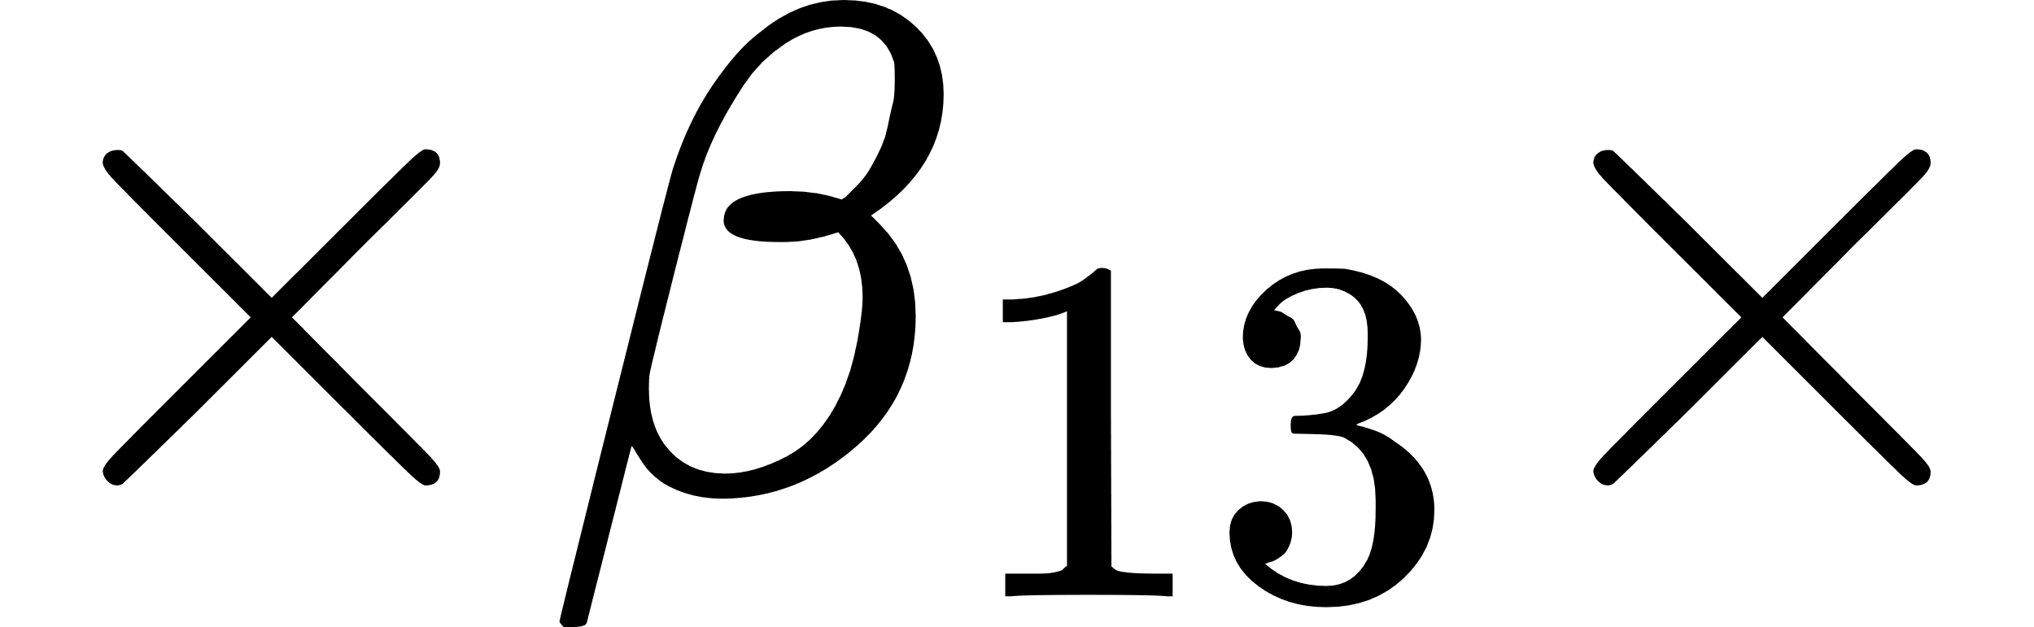
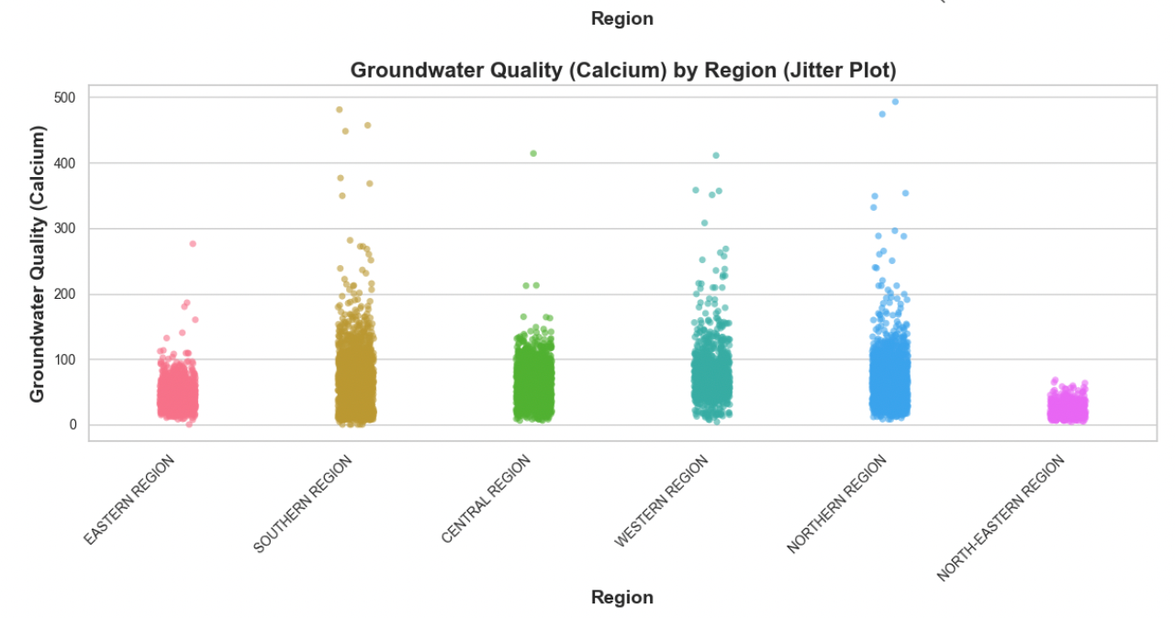
Interpreting Coeffecients of SDP
Since the coefficients for SDP, SDP2, and SDP3 are highly correlated with each other, it’s difficult to interpret each coefficient individually. However, considering other independent variables such as Gini to be constant, we can rewrite the equation as:
Now, taking the partial derivative of GWQ with respect to SDP , we get:
This implies that for a one-unit increase in SDP in the Central Region, holding other variables constant, the GWQ is expected to change by the sum of the coefficients β1, β11, plus twice the sum of the coefficients β2, β12, times the value of SDP, plus three times the sum of the coefficients β3, β13, times the square of the value of SDP.

Slide 29
Limitations
The decision to use state-level SDP instead of district-level SDP could introduce measurement error. While this assumption was made due to data availability constraints, it may not accurately capture economic disparities within states. This approach overlooks potential variations in economic activity at the district level, impacting the precision of the analysis
Although our analysis consistently yields p-values close to zero, indicating statistical significance, it's important to consider the implications of large sample sizes. As highlighted in Lin et al. (2013), in large datasets, p-values tend to converge to zero, potentially leading to inflated significance levels. This phenomenon, known as the p-value problem in large samples, suggests that p-values may not accurately reflect the true significance of our model.

Slide 30
Thankyou

